Slide 1

The
Digital Marketing
Includes Detailed Slides & Templates:
An Entire Digital Strategy on One Page
Audience & Persona Profile
Customer Problems Template
Customer Journey Map
Positioning Approach
Digital Funnel Slide
Digital KPI Tracker
Power Pack
Five Foundational Tools for a Digital Marketing Strategy
Book Time Via Calendly:
https://calendly.com/adamcfischer/conversation-with-adam
Strategy Kiln
Reach Out: Questions@StrategyKiln.com

Slide 2
Most companies waste an enormous amount of money on marketing because they have a mediocre strategy behind it
Get the same strategies Fortune 500 companies use and apply them to your small business for proven results

Slide 3

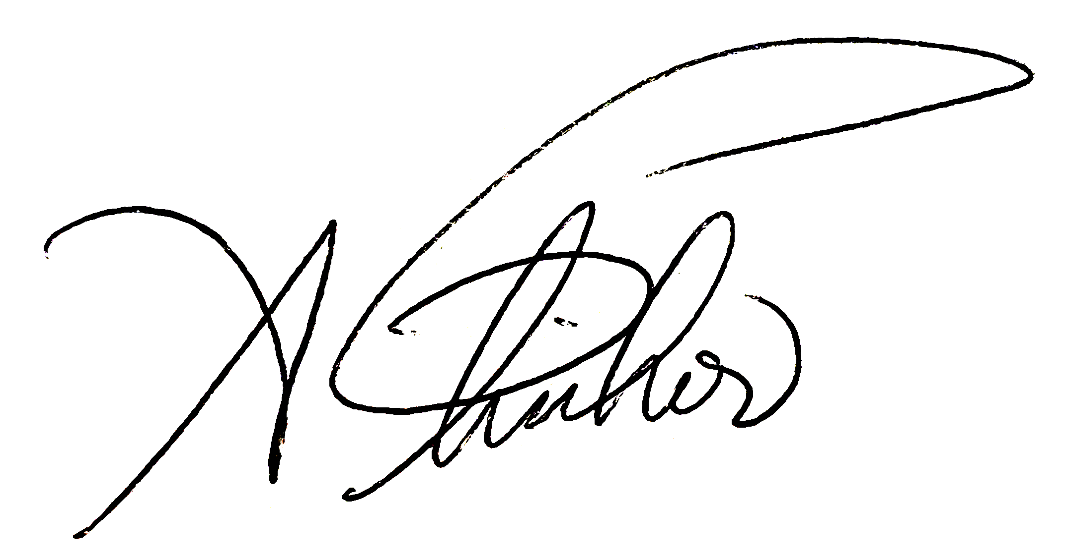

Power Pack
Our Approach
Five Foundational Tools for a Digital Marketing Strategy
Digital Marketing
The ATP model stands for:
  Audience
  Troubles (what troubles your customer)
  Place (where they are in their journey)
  Positioning
  Promotion
By getting these all on a page together, we can build a digital marketing strategy to attract your ideal customer.
This deck gives you the five key components of the ATP framework, plus a bonus KPI tracker. Strategy Kiln is happy to do this process for you.
Architects and Builders tell me all the time – “I’ve tried marketing in the past and wasted money. It doesn’t work for me.”
The agencies you tried may know marketing, but they don’t know you. They haven’t taken the time to understand your business or your customers. This disconnect is where the wheels fall off, and why marketing efforts fail.
That’s why I go deeper to get a holistic view of your business, customer, and precise ways to drive growth. Then, I take my experience managing multi-million dollar marketing budgets at Fortune 500 companies and fast-track these techniques to grow your small business.
3
Adam Fischer
Head of Content &
CMO for Hire, Strategy Kiln
Book Time Via Calendly:
https://calendly.com/adamcfischer/conversation-with-adam
Putting it all together: A Complete Digital Strategy on One Page using ATP
(see slide 17)

Slide 4
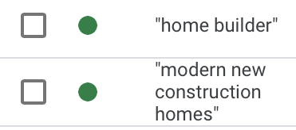

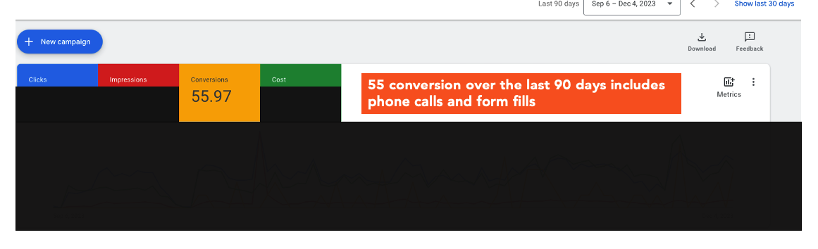
Quick Look: Strategy Kiln Paid Search Results for a Custom Home Builder via Google Ads
Google Paid Search is a great lead gen channel to capture relevant traffic. Test it quickly with a high intent audience and see results within weeks.
Dedicated campaigns and optimizations based on high intent keywords people are searching for like “custom home builder” ”architects near me”
Multiple leads for custom home builds over $1MM

Slide 5
Audience & Customer Personas
We provide an analysis of your audience and produce customer personas with demographics, psychographics, and behavioral data in a simple visual with actionable insights
1

Slide 6
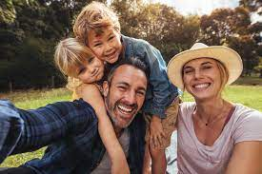
Target Customer Persona: B2C Home Buyer
GOALS & OBJECTIVES
Return on investment
Lifestyle enhancement
NEEDS
Personalization
Smart home integration
Prime location
MOTIVATIONS
Fulfillment of aspirations
Status and prestige
PAIN POINTS
Don’t know where to start
Cost and budget
Construction delays
Partners who overpromise
Chloe & Steve Johnson
AGE: 35
STATUS: Married
OCCUPATION: Business
CHILDREN: 2
LOCATION: Falmouth
INCOME: $500k+
Where do they conduct research?
Houzz
Pinterest
PERSONALITY
Confidence
OBJECTIONS TO MOVING FORWARD
Time and commitment
Want the cheapest initial price
Flexibility
Urgency
Trust
BUYING INFLUENCE
KEY MOMENTS & BEHAVIORS
They Research 3-5 builders, narrow it down to 2
Starts out with a low number for a house, then increases significantly as the process goes on
Price must be close, but personalization and person relationships wins
Online
Word of Mouth
Architect
Realtor

Slide 7
2
Troubles
Get to know your customer’s problems -
what troubles them?
When you quantify the severity of your customer’s problems and compare how you deliver value vs. the company, you see opportunity and challenges in a new way

Slide 8
Customer Problems vs. Your Ability to Deliver Solutions
Analysis outlines our unique ability to win by guiding the customer through this complex journey
What Troubles Our Customer? (Customer Problems) | Customer Need or Pain Level | How Well We Deliver a Solution | Our Solutions and Offerings/Benefits | Advantage vs. Competition
There’s so much to do when building a new home, where do I start? | 10 | 10 | Act as a single point of contact with Design Build | 7
How do I sell my current home and find land to build on? | 7 | 8 | Referral to real estate partners | 7
I want to see some plans, cool looking home designs that I like, and find an architect/designer to help me | 10 | 5 | Develop content | 0
Should I build a standard or green home? | 8 | 8 | Develop content | 8
How can I stick to budget? | 9 | 9 | Develop content around process | 9
I don’t want this process to consume my life | 8 | 8 | Explain time savings via content | 8
When you focus on the most severe customer problems and deliver value beyond your competitors, you can build a foundation for marketing

Slide 9
3
Place:
Identify the Key Moments
of the Customer Journey
Research and document your customer’s mindset and key actions in the beginning, middle, and end of their search for solutions to their problems
When you know them deeply, you can target and help them better than the other guys

Slide 10
Place: Customer Journey Map
Where, how, and why consumers arrive at the decision to buy
Awareness
Consideration
Purchase
Courtship and Honeymoon
Proposal
I can’t believe I married you!
Should I?...
Buy a traditional home, custom build, green home, or transitional home?
How to find the right team: Start w/ a buyers agent (real estate agent), architect, or Builder?
Who has the best portfolio?
Who has the best sense of my needs (do you “get” me)?
Who allows the best flexibility around customization/personalization?
This will never end
Indecision: “I don’t think I like the kitchen countertops, can we change them?”
  Mindset
Confused about where to start
Excited about the possibilities
Hesitant (and nervous) to make a decision on what home and who to work with, but also wanting to get started
Overwhelmed with selecting materials
I hate this process
I’m excited that we’re almost done!
  Emotions
Research Phase
  Find reviews: Google, Houz, Yelp, IG portfolios, Pinterest Idea Books
  Learning more about what neighborhood, style, materials, and designs they like
  Building idea books on Houz and Pinterest
  Determining lot + build budget
  Spouses discuss what each wants – will this home work as our family grows?
Acquire financing
Review decision criteria: home quality, process (branded SOP), best design, customer centricity, technology, quality of team
What are the standout decision drivers?
  Reviewing Standard items vs. upgrades (smart tech, elevator, green upgrades)
  Man cave? Chef’s dream? Natural light? Sense of belonging/community in home? Storage?
  Any cool feature (e.g. healing center), or technology that we can tell a story with to grab attention?
Construction
Complete finishing touches
Inspections & walk throughs
Move-in
Home care & maintenance
  Actions

Slide 11
Positioning
Claim a unique positioning that sets you apart from the competition and sets you up for growth
4

Slide 12

Find Your Positioning in the Market
Shaping the mind’s of our audience to influence their buying decisions
Differentiated Positioning
What customers want
What your brand does best
STORYBRAND GUIDE EXPERTISE
As the only certified Storybrand guide in Rhode Island, I’m trained to craft a unique position and
story for your brand.
Customer’s
aren’t interested
Can’t
Compete
What your competition does best
Risky due to
intense competition
With a differentiated positioning, you can market to the right person with the right message at the right time. You just need the right digital channels to promote your message...
Notes:
Note: Craft brands will grab a small sliver of the where to win pie

Slide 13
5
Promotion
Build a Digital Marketing Funnel
We’ll map out the paid, owned, and earned channels you’ll focus on
Keep it simple, and focus on having a well rounded approach to both capture demand and generate demand

Slide 14
Marketing Funnel Overview
Marketing priorities mapped to areas of the funnel across paid, owned, and earned channels
OWNED
PAID
EARNED
Website
Facebook/IG
E-mail
Other
Create Interest
(Leads)
Facebook/IG
Google
Other
Build the Brand
(Traffic)
Brand story development
SEO Strategy & Activation
Drive Conversion
(Deals)
Webinars
PR firm selection
Docuseries development
Print
Blog & Content Plan
PMAX
Houzz
Video
Nurture Series (Active Campaign software)
Article creation
Display
Events
Boosted posts
Best of – Houz, etc. lists
HARO tool test
Plan for current list
Plans for new subscribers
Referrals
Site partnerships
Lead Magnets
Retargeting
Landing page development
(Leadpages software)
Retargeting
Constant testing
High intent search terms

Slide 15
BONUS
Track Your Performance & KPIs
Create a visual dash that maps performance against each section of your funnel

Slide 16
Digital Funnel KPI Tracker
Allocating budget towards optimal channel mix for volume of new customers and efficient CAC
Build the Brand
Create Interest
Drive Conversion
KPI | Audio/CTV | Programmatic | Facebook/IG | Paid Search | LinkedIn | Monthly Totals
Monthly Budget | $300,000 | $300,000 | $400,000 | $500,000 | $40,000 | $1.5MM
Impressions per mo. | 2,046,187 | 2,407,867 | ~1MM | 331,878 | ~240K | ~7MM
CPM | $216.51 | $8.97 | $25.45 | $254.98 | $28.86 | $21.09
CTR | - | 0.09% | 1.78% | 6.4% | 1% | 2%
CAC | $491.80 | $743.51 | $116.56 | $117.11 | $1,302 | $389.00
Targeting Approach | B2C | B2B | B2C | B2C | B2B | -
Markets | Atlanta, Detroit, Miami | Priority + Focus Markets | Priority + Focus Markets | Priority + Focus Markets | Priority + Focus Markets | -
Recent Optimizations | - | Machine Learning + New Ads | Machine Learning + New Ads | Machine Learning + New Ads | - | -
Future Optimizations | Shifting the full podcast spend to streaming Add Additional Markets | Creative + Market Optimizations | Creative + Market Optimizations | Creative + Market Optimizations | Additional Focus on Strategy + Creative & Market Optimizations | -
Cost Reduction Focus | ​ |  | YES | YES |  | -
Notes:
Note: Craft brands will grab a small sliver of the where to win pie

Slide 17
A Digital Marketing Strategy on One Page
When you put your whole digital approach on one page using the ATP framework, you get clarity
When you get clarity,
you get traction
Then you get results

Slide 18
ATP
Framework for a Complete Digital Marketing Strategy on a One Page
Audience (New Home Buyer Example)
What Troubles Them?
KEY PERSONA
Chloe & Steve Johnson
AGE: 35-50
STATUS: Married
OCCUPATION: Business
CHILDREN: 2
LOCATION: Chicago, Ill.
INCOME: $500k+
BUYING INFLUENCE
Customer Problems | Need or Pain Level | How Well We Deliver | Advantage vs. Competition
There’s so much to do when building a new home, where do I start? | 10 | 10 | 7
How do I sell my current home and find land to build on? | 7 | 8 | 7
I want to see some plans, cool looking home designs that I like, and find an architect/designer to help me | 10 | 5 | 0
ADDITIONAL DETAIL
Affluent families looking for a custom home that reflects their personal identity
Seek comfort and care about sustainable design
Place Where are they & what are the key journey moments?
Positioning
Promotion
Build a Sales Funnel
Awareness
Consideration
Purchase
FOR
Top
Local Magazines
IG Storytelling & portfolio sharing
Content & SEO
PR
Direct Mail
Houzz Pro
Video for Facebook
Lead Magnets
Paid search
E-mail nurtures
[target customer]
Find reviews: Google, Houzz, Yelp
Look at designs: Find idea books on Houz and Pinterest
Who has the best portfolio &
sense of my needs?
Who has the best quality, process (branded SOP), design, customer centricity, technology, & team?
Major decision drivers: Price & value
Who can I communicate w/ easily & trust?
[their experience, needs,
wants, acute pains]
WHO
Mid
Referrals & Home Maintenance
WE PROVIDE
[offering: services,
products, process]
THAT
[features and functional
benefits]
KEY MOMENTS & BEHAVIORS
Research 3-5 builders, architects or designers, narrow it down to 2
Starts out with a low number for a house, then increases significantly as the process goes on
Price must be close, but personalization and personal relationships win
Bot
RESULTING IN
[dream outcome, emotional
value to clients]

Slide 19
Send an e-mail:
Questions@StrategyKiln.com
Simplify & Intensify your Marketing with Strategy Kiln
Reach Out
Learn More About Services
Services to Gain Insight, Attract Customers, & Grow Strategically
Fractional CMO
Digital Sales Funnel
Value Proposition
SWOT Assessment
SEO & SEM
Blue Ocean Strategy
Website Design
Lead Magnet Creation
Email Strategy
Paid Social Media
Need help?
We’ll complete all or part of the ATP framework and execute your digital marketing strategy
Book Time Via Calendly:
https://calendly.com/adamcfischer/conversation-with-adam

Slide 20
The Team

Slide 21


ADAM FISCHER
SETH FINK
Your
Team
BRAND STRATEGY & DIGITAL MARKETING
BRAND STRATEGY & OPERATIONS EXPERTISE
15+ years of experience at Fortune 500 companies & start-ups
CPG and Healthcare background
Omni-channel launches with full-funnel digital & traditional strategy
Influencer marketing, paid search (Google), and paid social (Facebook) expertise
At Nature Made Vitamins: Positioned and launched a new differentiated probiotics line to drive +25% top line growth (includes Costco and grocery channel sales expertise)
At a $1B unicorn start-up: Achieved +70% sales growth through a hyper-local digital strategy to secure $115MM in Series C funding
30+ Years of senior executive & strategy consulting experience at premier firms like Deloitte, PWC, & Anderson Consulting
Significant retail experience including the launch of the NBA and NBC retail stores in NYC and the UPS retail store nationwide launch
Extensive global business insights, country management, & new product launch experience
Operational assessment and optimization expertise, including multiple years with Walmart
Deep Thinking
Simplicity
Boldness
Empathy
Impact
- Strategy Kiln Values -

